Slide 1
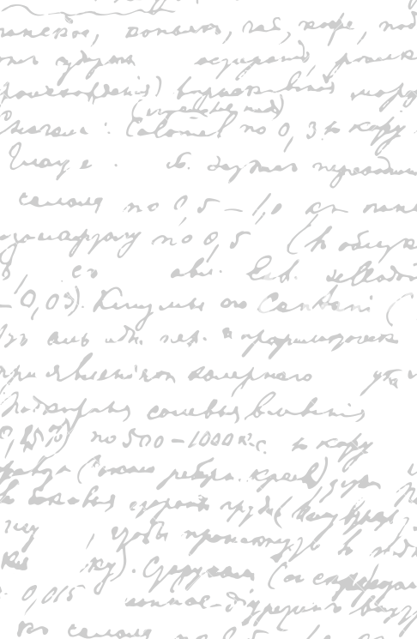

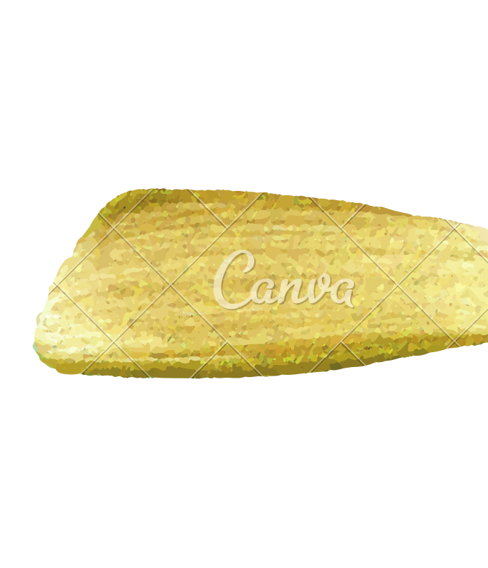

Ming Wu (Andrew) 2133861w
Laser Mate!
Project Supervisor Meeting 18
1 April 2021

Slide 2
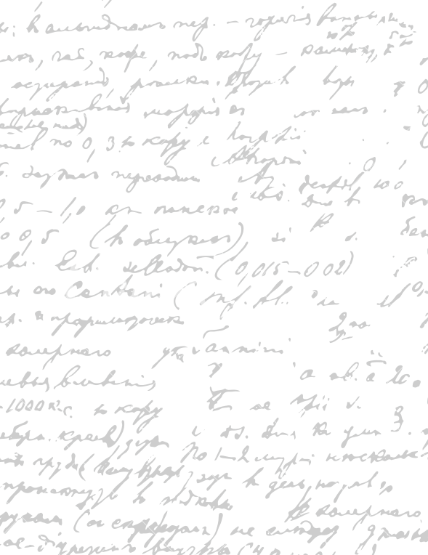



Start Recording

Slide 3
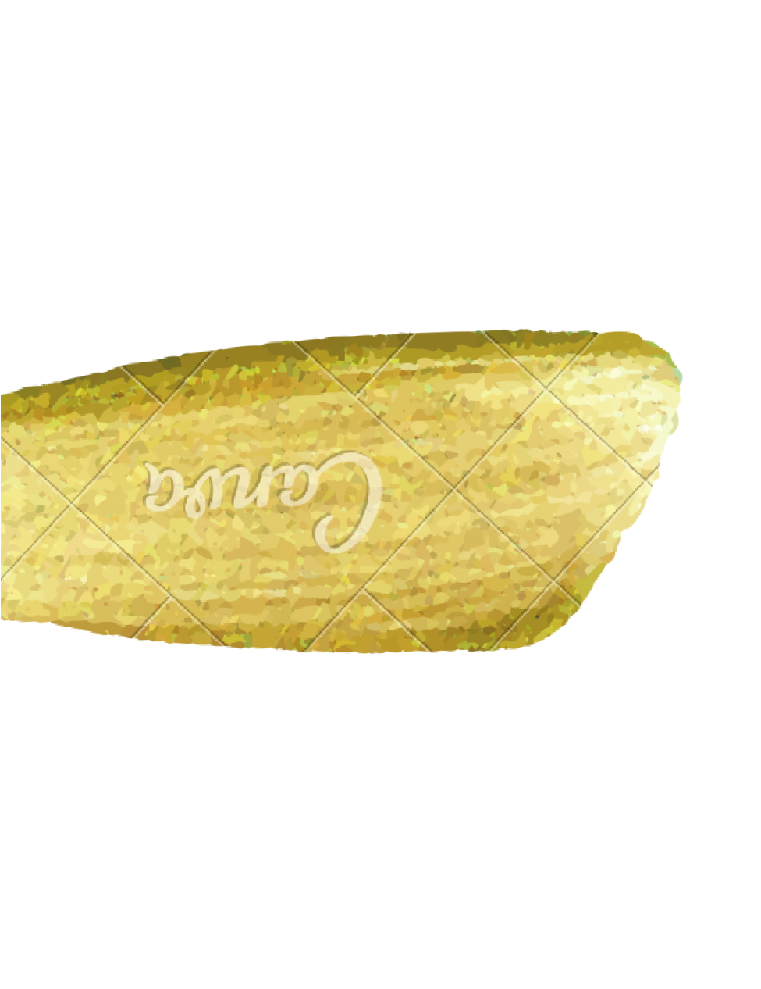
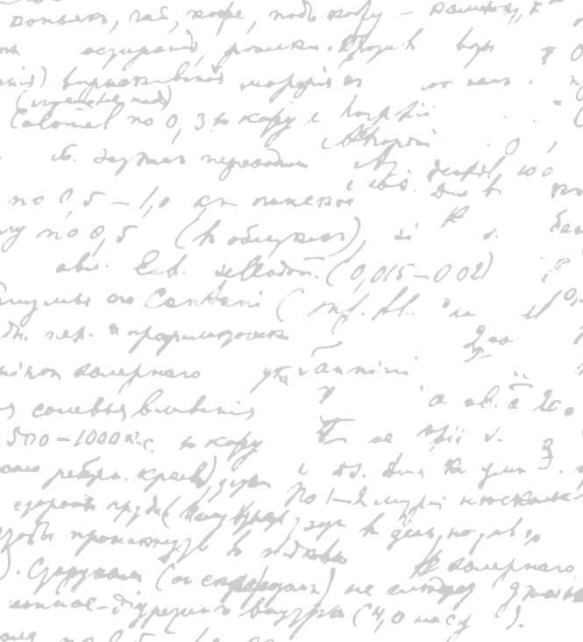
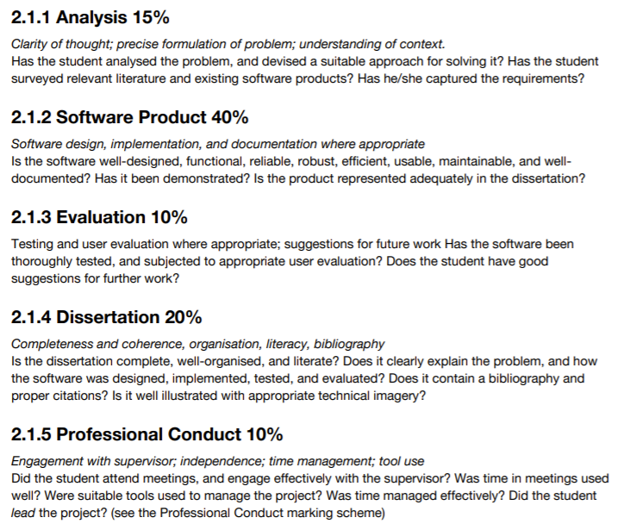

Cross-checking Dissertation
- Describe each dissertation part (Analysis, Software Product, Evaluation, Dissertation)
Discuss what is good, what is missing, what can be improved
Competitor, similar software UberEat, what are they like, what other things are there, are they good/ bad product, what is out there, what are the problems out there
Iterative design – explain

Slide 4
End

